Slide 1
A&P Unit 4
Lecture 6A

Slide 2
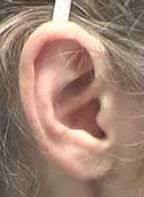
External anatomy of the ear
Helix
Triangular Fossa
Concha
Pinna
Tragus
Antihelix
Lobule
Antitragus

Slide 3
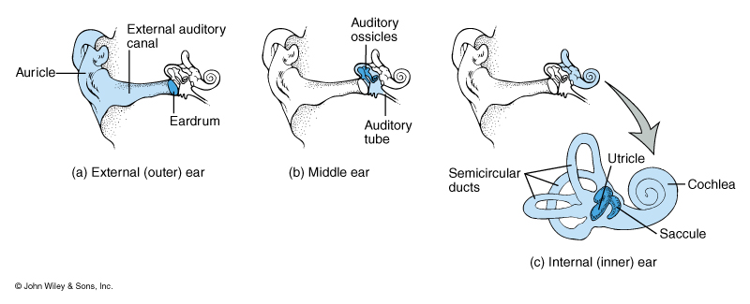
Three Parts of the Ear

Slide 4
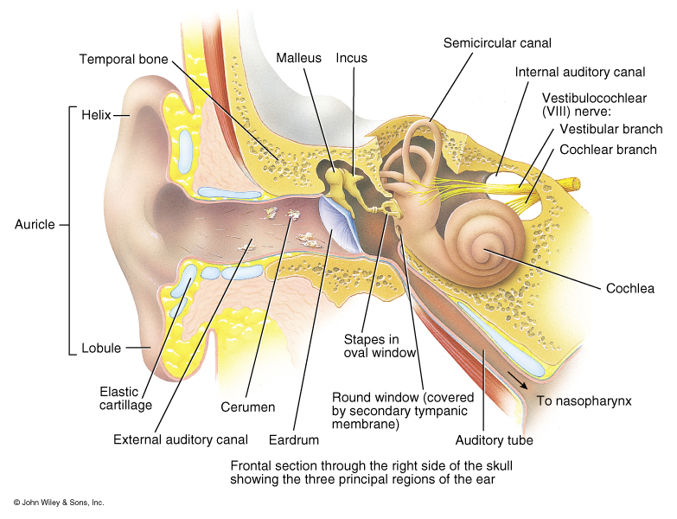
Overview of the anatomy of the external ear, middle ear and internal ear

Slide 5
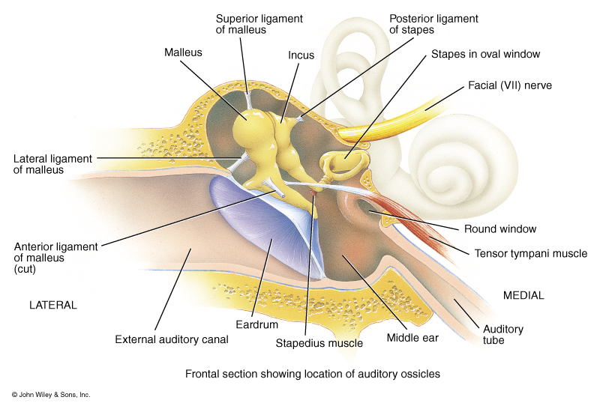
Gross Anatomy of the Middle Ear

Slide 6
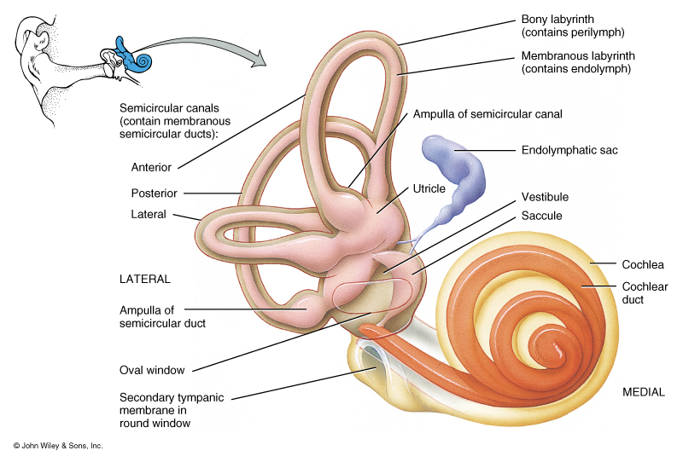
Gross Anatomy of the Inner Ear

Slide 7
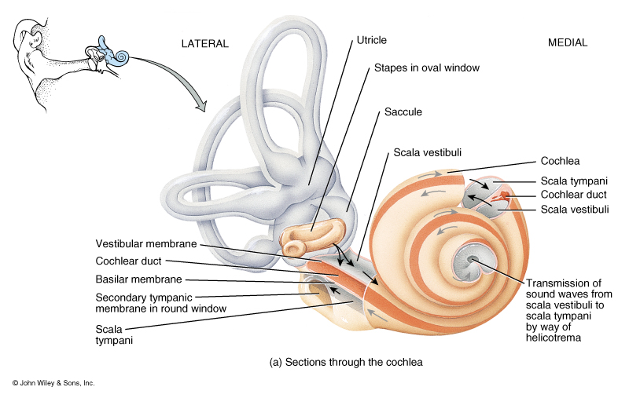
Anatomy of the Cochlea

Slide 8
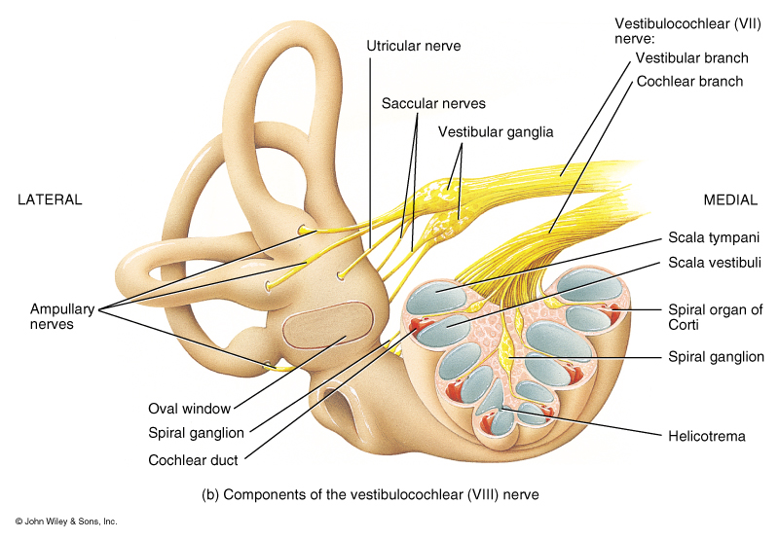
Sectional View of the Cochlear as it will appear on a microscope slide

Slide 9
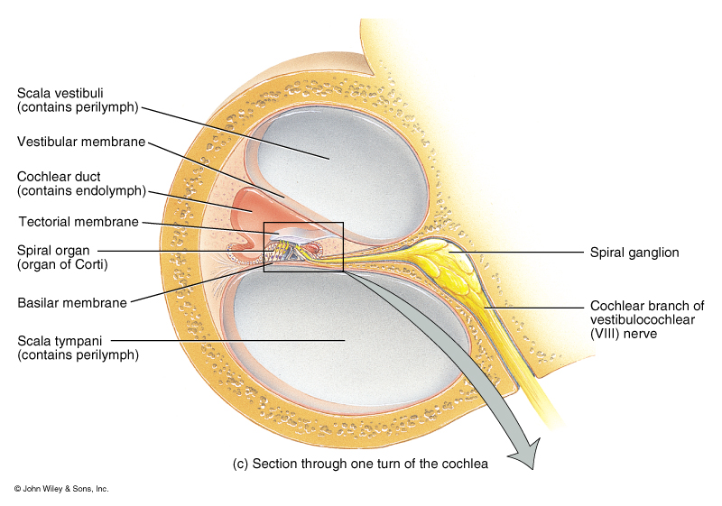
Internal Anatomy of the Cochlea with details of the Bony Labyrinth

Slide 10
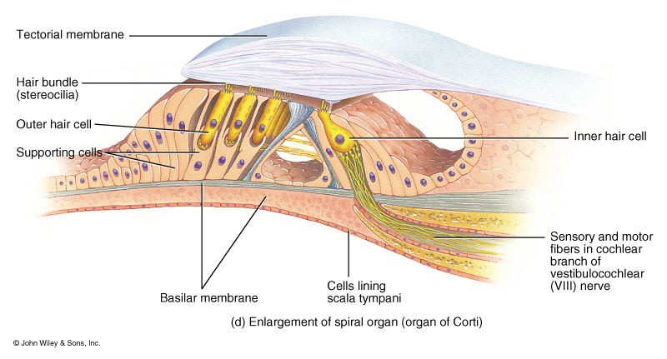
Internal Anatomy of the Bony Labyrinth with details of the Organ of Corti

Slide 11
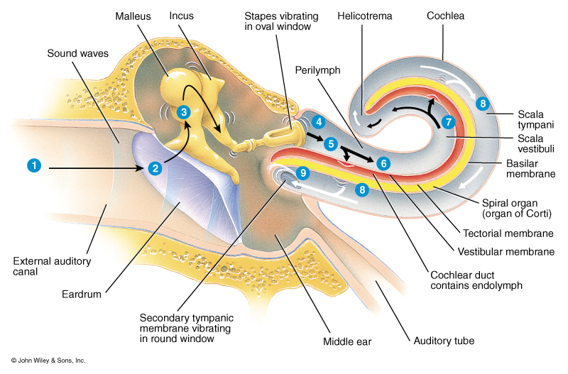
Events involved in the creation of an Auditory action impulse
Pinna directs sound waves
into the external auditory
meatus.
Sound waves cause the
tympanic membrane to
vibrate.
a. Slowly for low-
frequency sounds
b. Rapidly for high-
frequency sounds
c. Distance the membrane
travels during these
vibrations relates to
loudness or decibels.

Slide 12
Events involved in the creation of an Auditory action impulse
Vibrations are communicated
from the tympanic membrane
to the auditory ossicles.
Malleus Incus Stapes
Stapes vibrates back and forth
in the oval window, thus
vibrating the oval window
membrane.
Vibration of oval window
membrane causes fluid pressure
waves in the perilymph of the
scala vestibuli.

Slide 13
Events involved in the creation of an Auditory action impulse
Perilymph pressure waves
are transmitted to the scala
tympani and eventually to the round window causing the secondary tympanic membrane to bulge outward.
Vibrations of the vestibular
membrane cause vibrations
of the endolymph within the cochlear duct.
Endolymph pressure waves
cause the basilar membrane
to vibrate.

Slide 14
Events involved in the creation of an Auditory action impulse
8a. Vibrations of the basilar membrane cause the the hair cells of the Organ of Corti to vibrate.
8b. Hair cells vibrate upward, bending the stereocilia against the tectorial membrane.
8c. Bending the stereocilia produces a receptor potential that ultimately leads to a action potential on Cochlear nerve.

